Slide 1
Module 4: Soils and Climate Change

Slide 2
Outline:
Soil and Climate: The Connections
Soil and Climate: The Carbon Cycle
Soil and Climate Change: Classroom Connections

Slide 3
Soil and Climate: The Connections
Task:
What connections are there between soil and climate?
What connections are there between soil and climate change?
Notes:
his slide is to measure the content knowledge/depth of the participants.
The slide is animated with the lines appearing one at a time. Elicit responses for their thoughts on the connections between soil and climate. Transcribe these on chart paper or a markerboard. Show the next line on the slide and ask participants for their thoughts on the connections between soil and climate change. Use a different color marker to list their responses or highlight responses from the previous question.

Slide 4
Soil and Climate: The Connections
Soil Formation
Drought
Climate
&
Climate Change
Soil Type
Flood
Carbon Sequestration
Erosion
Notes:
If time, ask participants to explain the links between the items listed in the slide. Press for domino effects of drought, flood, erosion, and carbon sequestration

Slide 5
Soil and Climate: The Carbon Cycle
Carbon Flows:
Where can we find carbon?
Where does it go? How does it get there?
Let’s build a Map of Carbon Flows!
Notes:
Facilitate Map-Carbon-Flows activity found in the participant materials (15 min) See Map Carbon Flow activity for details.
Materials: Prep arrows and 5 starter cards
The activity is well designed, but it should be rehearsed ahead of the workshop. The activity can be lengthened or shorten depending how much time is available. Read the activity to identify places where the activity can be modified. Allow time for participants to visit other tables to see how others created their models. Ask them how the models were the same or different.

Slide 6
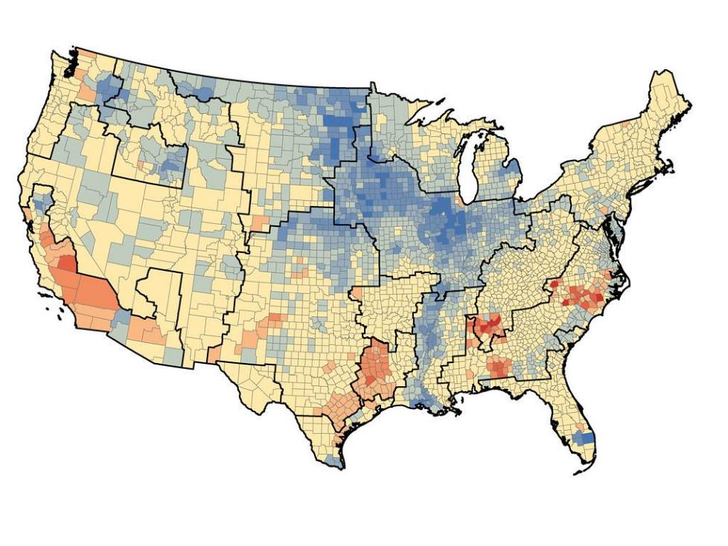
Carbon Cycle, Soils, and Climate
Blue = Carbon sinks
Red = Carbon sources
Notes:
Net Carbon Exchange in U.S. Crop Production
Based on U.S. crop production, scientists determined which American regions are carbon sinks, or those that take in more carbon than release it, and carbon sources, or those that release more carbon than they take in. Their calculations showed that the most agriculturally active regions, shown in blue, are carbon sinks while the regions with larger populations, shown in red, are carbon sources.
https://www.eurekalert.org/news-releases/742938
Figure courtesy of Pacific Northwest National Laboratory.

Slide 7
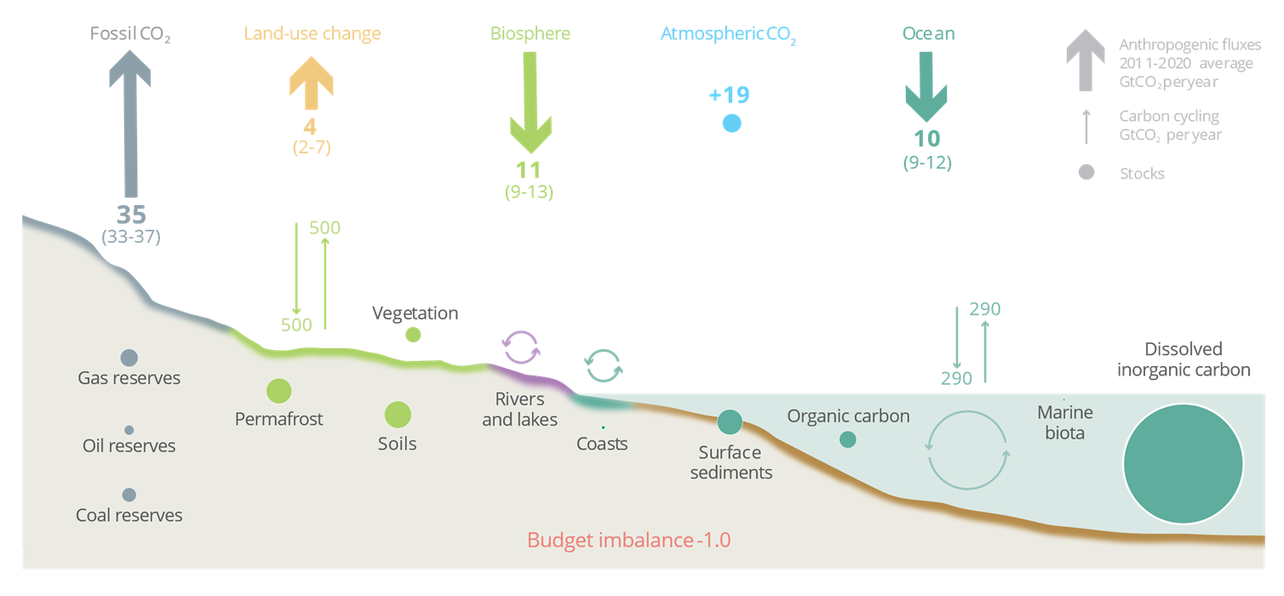
2021 Carbon Budget
Notes:
Use this slide to identify the different sources and sinks in our current carbon cycle.
he budget imbalance is the difference between the estimated emissions and sinks.
Source: NOAA-ESRL; Friedlingstein et al 2021; Canadell et al 2021 (IPCC AR6 WG1 Chapter 5); Global Carbon Project 2021
https://www.globalcarbonproject.org/index.htm

Slide 8
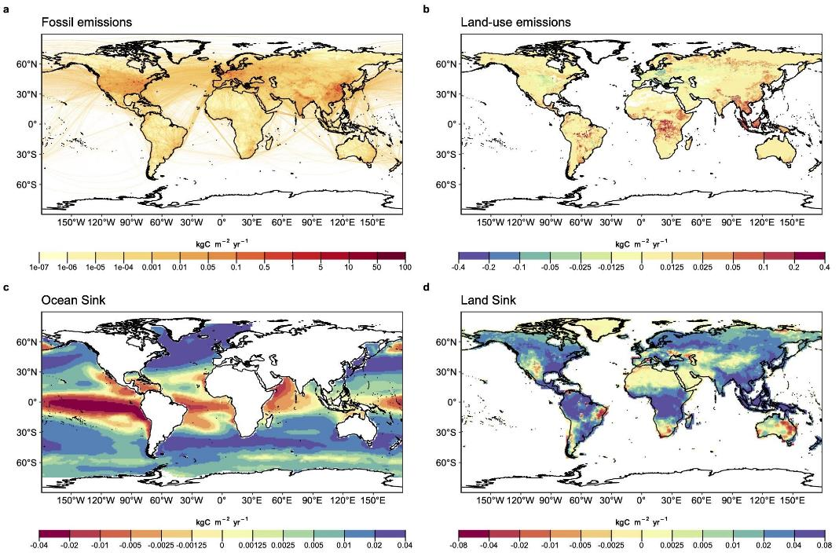
Global Carbon Budget
Fossil emissions dominate in the Northern Hemisphere, while land-use emissions are important in the tropics. The North Atlantic and Southern Ocean are carbon sinks while the tropical ocean is a source of CO₂. Tropical, temperate and boreal forest are the main terrestrial carbon sinks
Notes:
Use this slide to highlight the global variability in the carbon budget, and that one solution for the reduction of carbon will not solve all the challenges we are currently experience at a global scale.
Source: Friedlingstein et al 2021; Global Carbon Project 2021

Slide 9
Soil Carbon - a Bank Account Analogy
Inputs (bank deposits)
Outputs (bank withdrawals)
vegetation litter
root exudates
living soil biota
deposition of eroded carbon
remains of formerly living organisms
microbial decomposition of organic carbon inputs to CO₂
dissolved and particulate transport of carbon through leaching and/or erosion
Notes:
For this slide and the next 3 slides, review the materials listed below to familiarize yourself with the analogy used to describe the soil carbon cycle.
Citations
Article:
Longbottom, T., et al (2022), What’s Soil Got to Do with Climate Change. GSA Today, 32(5), p 4-10.
Graphic novel/Comic:
Berhe, A. A, & Sequential Potential. (2021). What's soil got to do with climate change?. Retrieved from https://escholarship.org/uc/item/4d76p54r
Ted Talk:
https://www.ted.com/talks/asmeret_asefaw_berhe_a_climate_change_solution_that_s_right_under_our_feet

Slide 10
Soil Carbon - a Bank Account Analogy
Slow Cycling (savings account)
Fast Cycling (checking account)
mineral-associated carbon in soil aggregates or chemically bound to the surfaces of reactive soil minerals
restrict decomposition, allowing it to persist in soils for long time scales
readily degradable and easily transported.
Critical for maintenance of life in soil since decomposition is the main mechanism that recycle nutrients for soil organisms
Notes:
From GSA Today May 2022 paper “What’s Soil Got to Do with Climate Change.”
The SOC that exists in soil can be subdivided into “slow-cycling” and “fast-cycling” pools akin to checking and savings accounts (Lavallee and Cotrufo, 2020), respectively. Slow-cycling C is either mineral-associated C that is found physically protected in soil aggregates or chemically bound to the surfaces of reactive soil minerals; both mechanisms restrict decomposition and associated losses of SOC, allowing it to persist in soil for decadal to millennial time scales (Schmidt et al., 2011; Hemingway et al., 2019). In contrast, fast-cycling C is more readily degradable and prone to physical transport in shorter time scales (Schmidt et al., 2011; Hemingway et al., 2019). Fast C cycling, which is akin to funds in a checking account, is critical for maintenance of life in soil, because decomposition is the main mechanism that recycles nutrients needed by organisms that call the soil home (Janzen, 2006). Even small, but sustained, deposits into the soil C savings account over time allow for long-term buildup of C in the slow-cycling pool with significant potential for climate change mitigation.

Slide 11
Soil Carbon - a Bank Account Analogy
There will always be “withdrawals” as the decomposition is needed for nutrient cycling
What are our “investment” opportunities? - “climate smart” soil management practices
4 per 1000 effort: Increase soil organic carbon by 0.4% annually = offsets one-third global fossil fuel emissions.
Notes:
From GSA Today May 2022 paper “What’s Soil Got to Do with Climate Change.”
The SOC that exists in soil can be subdivided into “slow-cycling” and “fast-cycling” pools akin to checking and savings accounts (Lavallee and Cotrufo, 2020), respectively. Slow-cycling C is either mineral-associated C that is found physically protected in soil aggregates or chemically bound to the surfaces of reactive soil minerals; both mechanisms restrict decomposition and associated losses of SOC, allowing it to persist in soil for decadal to millennial time scales (Schmidt et al., 2011; Hemingway et al., 2019). In contrast, fast-cycling C is more readily degradable and prone to physical transport in shorter time scales (Schmidt et al., 2011; Hemingway et al., 2019). Fast C cycling, which is akin to funds in a checking account, is critical for maintenance of life in soil, because decomposition is the main mechanism that recycles nutrients needed by organisms that call the soil home (Janzen, 2006). Even small, but sustained, deposits into the soil C savings account over time allow for long-term buildup of C in the slow-cycling pool with significant potential for climate change mitigation.

Slide 12
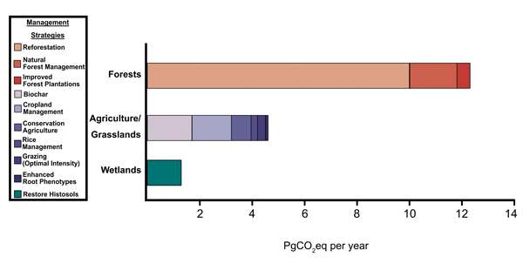
Soil Carbon - a Bank Account Analogy
Notes:
https://www.geosociety.org/GSA/Publications/GSA_Today/features/GSA/GSAToday/science/G519A/article.aspx
Figure 2. Various management strategies in forested, agriculture/grassland, and wetland ecosystems exhibit differing propensities to take up CO2. Overall, these strategies represent a way to expand terrestrial ecosystem uptake of carbon (Friedlingstein et al., 2020; Paustian et al., 2016; Griscom et al., 2017).
From Left to Right
Forests: Reforestation, Natural Forest Management, Improved Forest Plantations
Agriculture/Grasslands: Biochar, Cropland Management, Conservation Agriculture, Rice Management, Grazing (optimal intensity), Enhanced Root Phenotypes
Wetlands: Restore Histosols

Slide 13
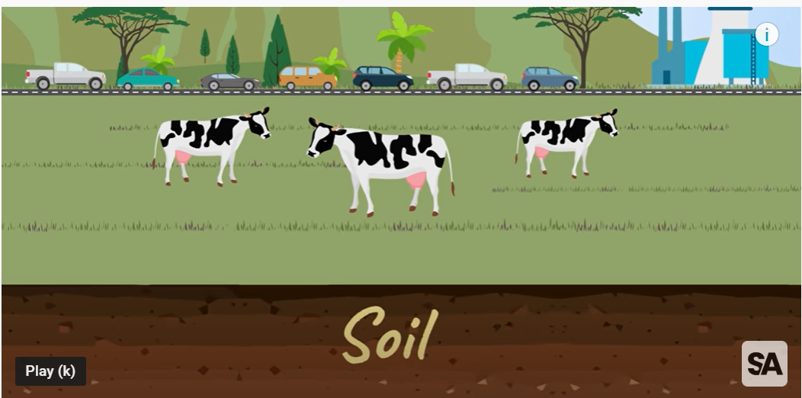
Soil Carbon Drawdown
Notes:
https://www.youtube.com/watch?v=xXo-9x1bSDU

Slide 14
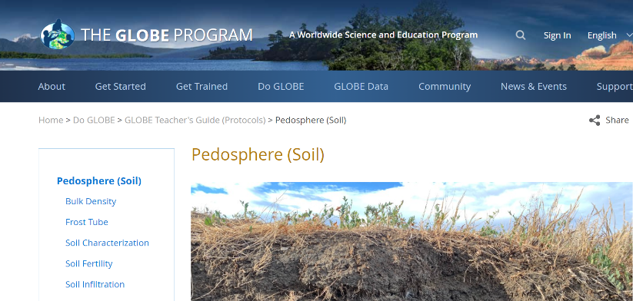
Soil and Climate: GLOBE Protocols
GLOBE Soil Protocols
Soil Bulk Density - an indicator of soil compaction, soil health, and carbon storage
Notes:
https://www.globe.gov/do-globe/globe-teachers-guide/soil-pedosphere
Mention that the GLOBE program soil protocols are student friendly and can be used as soil science labs. However, the GLOBE protocols are designed for students to use to collect and upload data into the GLOBE program over time.
In general, soil bulk density can range from 0.5 g/mL or less in organic soils with many pore spaces, to as high as 2.0 g/mL or greater in very compact mineral horizons.

Slide 15
Soil and Climate Change: Classroom Connections using a 5E Lesson-set

Slide 16
Phenomenon: Soil & our Climate System
Engage
Explore
Explain
Elaborate
Evaluate
Notes:
Review the materials shared in the Module 4 Resources document.

Slide 17
Phenomenon: Soil & our Climate System - Engage

Slide 18
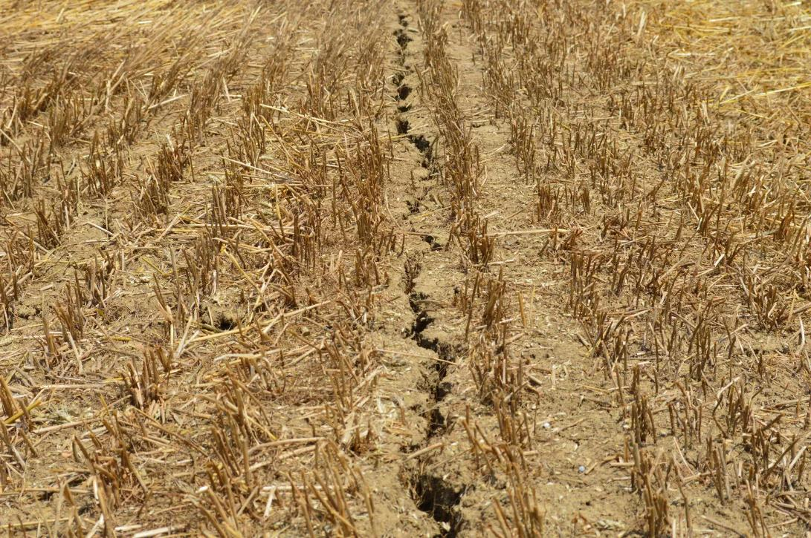
Engage - What do you see? What do you wonder? What questions do you have?
Notes:
Locate an image that will elicit student responses that can connect soil and climate change.
Climate change and arid soil
by Andrea Carri
This photo, taken during last summer, could be a symbol of the drought recorded in Italy.
Taken on 28 June 2017
Submitted on 14 February 2018
Exact location (10.5334 E, 44.7860 N)
https://imaggeo.egu.eu/view/12832/

Slide 19
Phenomenon: Soil & our Climate System - Explore

Slide 20
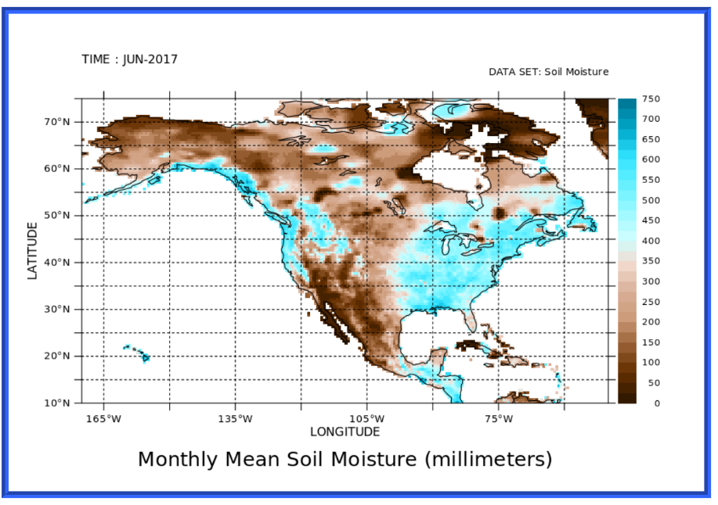
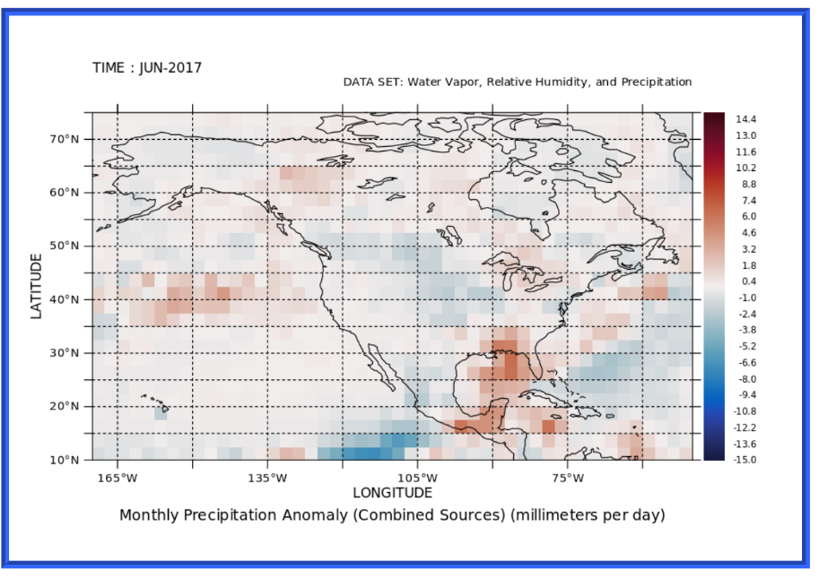
Explore
Monthly soil moisture data vs Monthly precipitation anomaly data
Notes:
The My NASA Data website has multiple activities related to soil moisture. https://mynasadata.larc.nasa.gov/ This data was gathered from their Earth System Data Explorer datatool.
Monthly soil moisture data in millimeters - for North America
Set time for animation to Jan 2015 to Dec 2021
https://mynasadata.larc.nasa.gov/EarthSystemLAS/ProductServer.do?catid=F999FEBAA1387D63AE2440D2314A232C&xml=%3ClasRequest%20href=%22file:las.xml%22%3E%3Cargs%3E%3Clink%20match=%22/lasdata/datasets/soil_moisture/variables/soilw-id-70637cbe91%22/%3E%3Cregion%3E%3Crange%20type=%22x%22%20low=%22-170%22%20high=%22-50%22/%3E%3Crange%20type=%22y%22%20low=%2210%22%20high=%2275%22/%3E%3Cpoint%20type=%22t%22%20v=%2201-Jan-1948%2000:00%22/%3E%3C/region%3E%3C/args%3E%3Clink%20match=%22/lasdata/operations/operation%5B@ID=%27Animation_2D_XY%27%5D%22/%3E%3Cproperties%3E%3Cferret%3E%3Cview%3Exy%3C/view%3E%3Csize%3E.8333%3C/size%3E%3Cimage_format%3Egif%3C/image_format%3E%3Cannotations%3Efile%3C/annotations%3E%3C/ferret%3E%3Clas%3E%3Coutput_type%3Ehtml%3C/output_type%3E%3C/las%3E%3C/properties%3E%3C/lasRequest%3E
Monthly Precipitation Anomaly in millimeters/day - for North America
Set time for animation to Jan 2015 to Dec 2021
https://mynasadata.larc.nasa.gov/EarthSystemLAS/ProductServer.do?catid=6C5387F89303C8F2A94AB07B9720E61D&xml=%3ClasRequest%20href=%22file:las.xml%22%3E%3Cargs%3E%3Clink%20match=%22/lasdata/datasets/WVavg/variables/precip-id-65348881a9%22/%3E%3Cregion%3E%3Crange%20type=%22x%22%20low=%22-170%22%20high=%22-50%22/%3E%3Crange%20type=%22y%22%20low=%2210%22%20high=%2275%22/%3E%3Cpoint%20type=%22t%22%20v=%2201-Jan-2015%2000:00%22/%3E%3C/region%3E%3C/args%3E%3Clink%20match=%22/lasdata/operations/operation%5B@ID=%27Animation_2D_XY%27%5D%22/%3E%3Cproperties%3E%3Cferret%3E%3Cview%3Exy%3C/view%3E%3Csize%3E.8333%3C/size%3E%3Cimage_format%3Egif%3C/image_format%3E%3Cannotations%3Efile%3C/annotations%3E%3C/ferret%3E%3Clas%3E%3Coutput_type%3Ehtml%3C/output_type%3E%3C/las%3E%3C/properties%3E%3C/lasRequest%3E

Slide 21
Explore - too little water
Drought: Withering Plants
https://www.windows2universe.org/teacher_resources/withering_crops_activity.html
and https://www.youtube.com/watch?v=cBqr43QbfBE
Notes:
The first link is to an activity where students examine the stomata of leaves under water stress and leaves that are healthy, and the second link is to a short (5-6 on) video on the effects of climate change on vegetation.

Slide 22
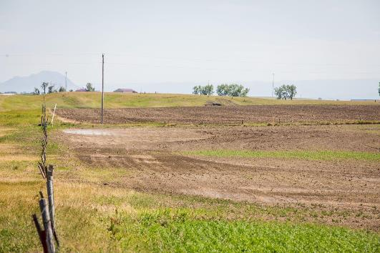
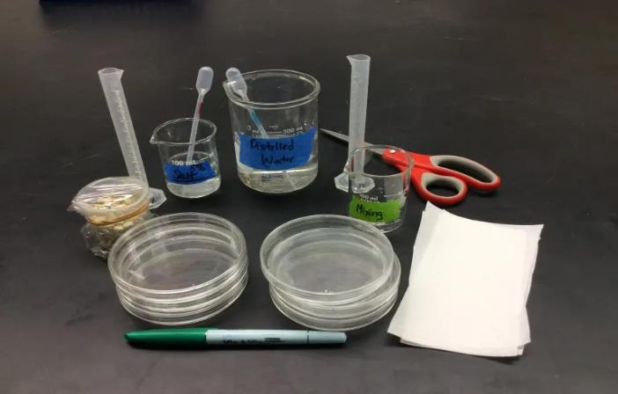
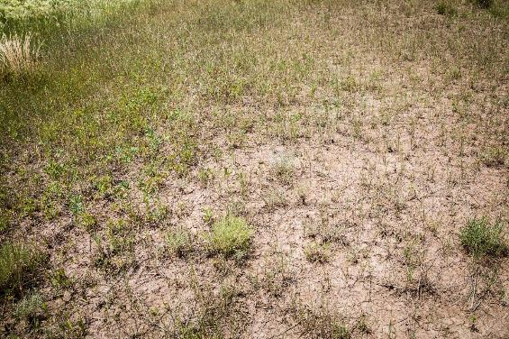
Explore - too little water
Soil Salinization Lab
Notes:
https://teachingapscience.com/soil-salinization-lab/
https://www.flickr.com/photos/nrcs_south_dakota/50727664467
https://www.flickr.com/photos/nrcs_south_dakota/50727572181/in/photostream/
USDA NRCS South Dakota
Seep in Western SD
Close up of soil and plant condition cause by seep on rangeland.
Resource Concern: Concentration of Salts and Other Chemicals
Salinity is a condition when water soluble salts have accumulated in the soil. Saline soils are indicative of inadequate drainage to leach salts from the soil or upward migration of salt from shallow ground water. Sodic soils are high in sodium relative to concentrations of calcium and magnesium. Salinity or sodicity occurs naturally or may result from management practices.
Saline seeps form due to insufficient water use in adjacent upslope recharge areas. Excess soil water moves through the soil profile collecting salts along the way. Eventually, that soil water with the dissolved salts encounters an impermeable layer, such as bedrock, and then moves laterally downslope to where a water table builds up. When the water table gets close to the soil surface, evaporation removes the water and salts are left behind. Over time, the area becomes so salty that only very salt tolerant plants can survive, if any plants at all. In South Dakota, this situation occurs primarily below cropland acres that traditionally have been in a wheat-fallow crop rotation. Even continuous small grain fields can lead to saline seeps due to the fact there are no (or very few) living plants to utilize soil moisture after crop harvest. However, saline seeps can occur downslope of native rangeland or tame pastures that have been over-utilized for many years. In these cases, the grass plant vigor has been depleted and the plants can’t utilize all the available soil moisture.
Conservation Practice: 610 Salinity and Sodic Soil Management
Proper management begins with the correct diagnosis of the problem area. Utilize the 610 Conservation Practice Specification Guide Sheet for the characterization and identification of saline and/or sodic areas.
Mitigation shall include vegetative measures to reduce subsurface water and salt movement from the recharge area to the discharge area. Vegetative measures include establishment of deep rooted perennial crops such as wheatgrass and the deeper rooted cultivars of alfalfa.
For more information on South Dakota's resource concerns, visit www.sdresrouceconcerns.org or www.farmers.gov/conserve/tool. You can also reach out to your local NRCS office or Conservation District. Find your local USDA NRCS office and employee directory at: bit.ly/ContactNRCSSD.

Slide 23
Explore - too much water
The Sponge Model
Notes:
https://www.doctordirt.org/teachingresources/sponge

Slide 24
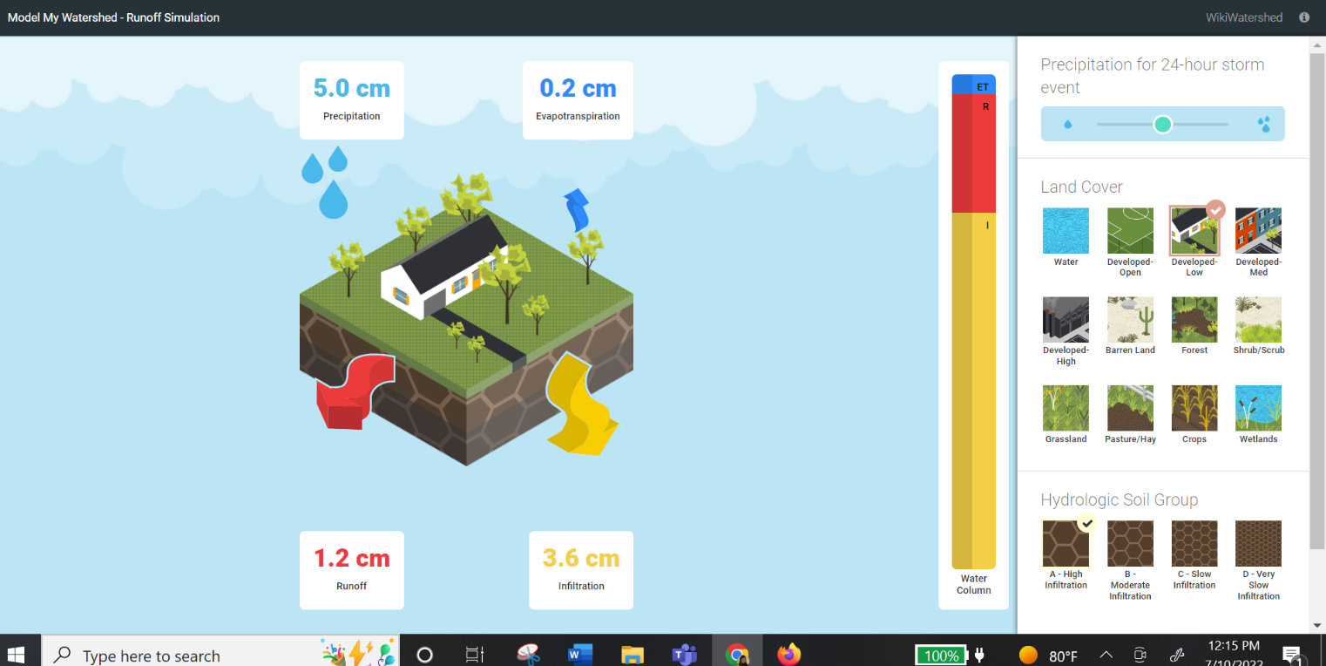
Explore - too much water
The Runoff Simulation
Notes:
https://stroudcenter.org/virtual-learning-resource/runoff-simulation/

Slide 25
Phenomenon: Soil & our Climate System - Explain

Slide 26
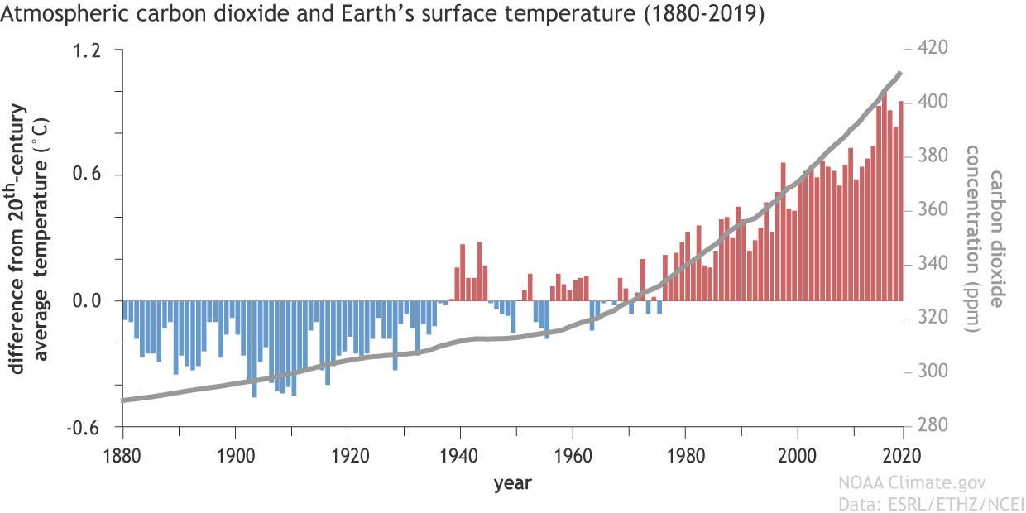
Explain - Carbon Connection
Notes:
https://www.climate.gov/media/11048
Students identify the correlation between carbon and temperature.

Slide 27
Explain - Positive Feedback….
Rising Temperatures
Drought
Less Sequestered Carbon

Slide 28
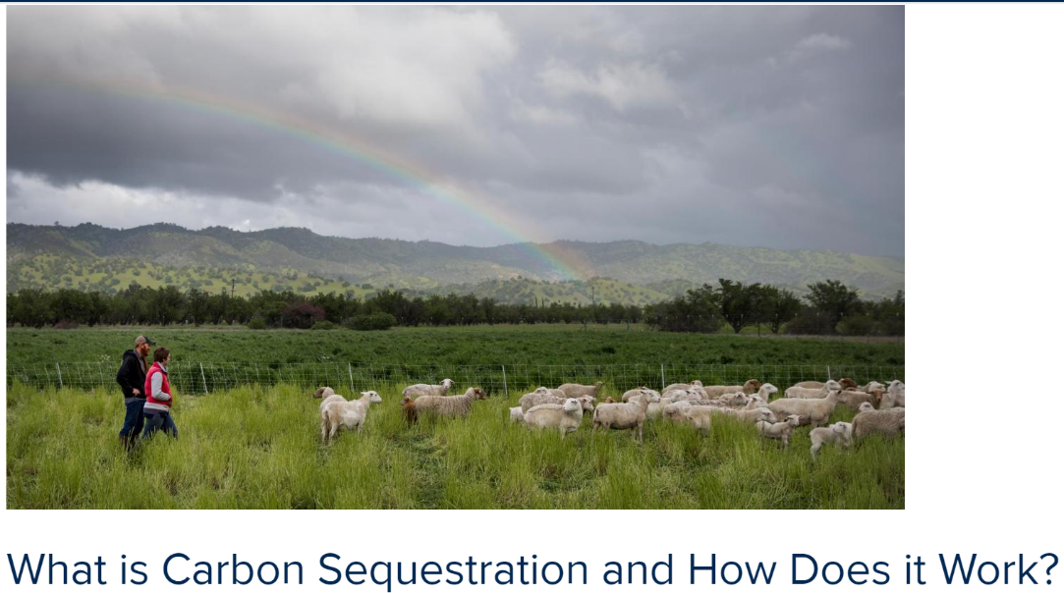
Explain - Carbon Connection
Reading: What is Carbon Sequestration
Notes:
What is Carbon Sequestration is a short, student-friendly reading about Carbon sequestration.
https://clear.ucdavis.edu/explainers/what-carbon-sequestration

Slide 29
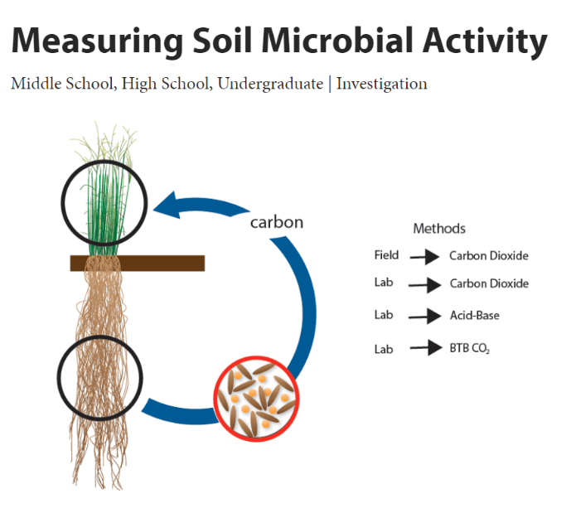
Explain - Carbon Connection
Lab Activity Exploring Plants and CO2 Exchange
Notes:
From: https://www.glbrc.org/outreach/educational-materials/measuring-soil-microbial-activity
Explain that this is one of many activities using probeware that may be available in high school or middle schools.

Slide 30
Phenomenon: Soil & our Climate System - Elaborate

Slide 31
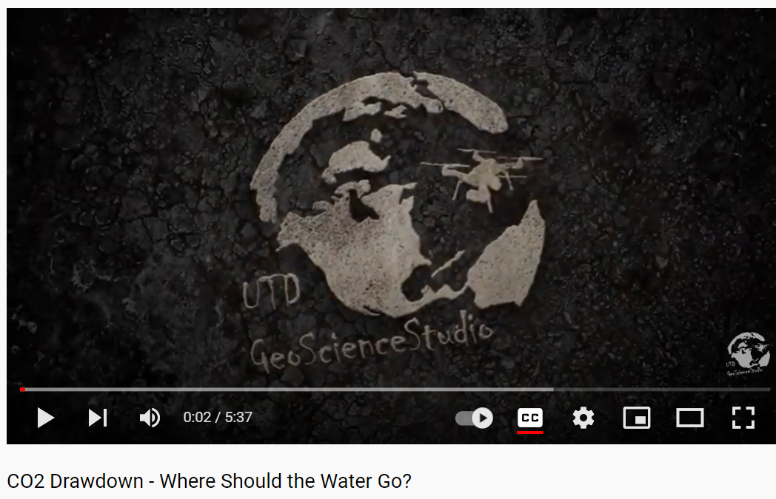
Elaborate
Let’s dig deeper into the soil-climate connection!
Video: CO2 Drawdown: Where should the water go?
Notes:
This video clearly explains the relationship between soil, plants, and water, and how together they store carbon in the soil.
https://www.youtube.com/watch?v=xv-n54NTd9M

Slide 32
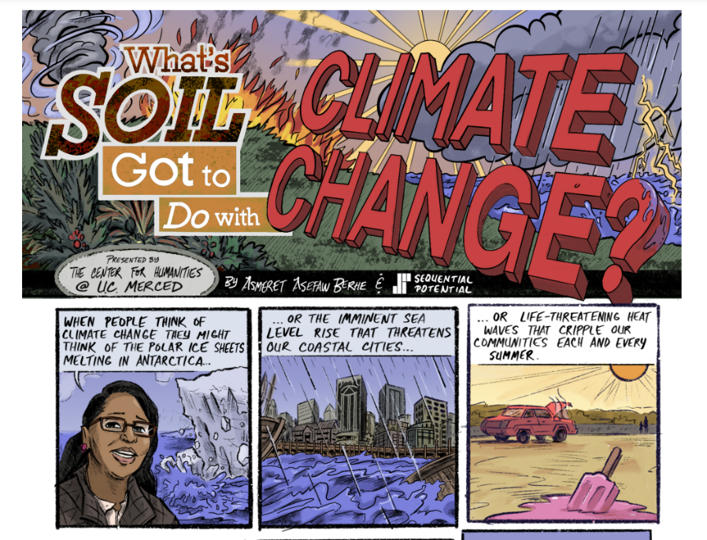
Elaborate
Let’s dig deeper into the soil-climate connection!
Reading: What’s Soil got to do with Climate Change?
Notes:
Mention this graphic novel/comic that uses the bank account analogy to explain carbon sequestration.
Berhe, A. A, & Sequential Potential. (2021). What's soil got to do with climate change?. Retrieved from https://escholarship.org/uc/item/4d76p54r

Slide 33
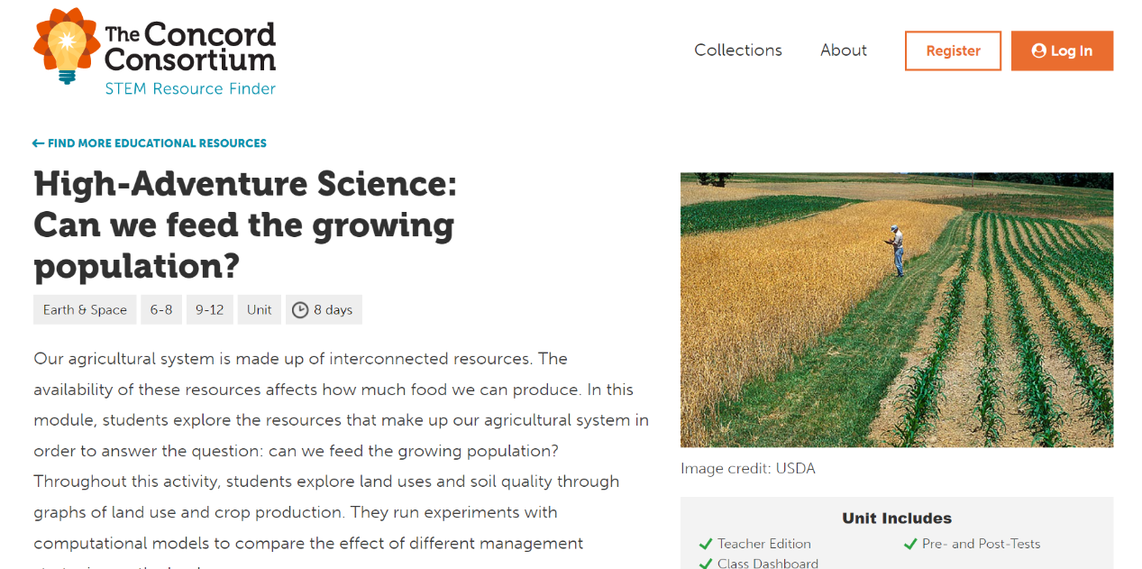
Elaborate
HAS: Can we feed the growing population?
Notes:
Can we feed the growing population? Is a Concord Consortium unit that includes a modeling tool to explore different farming methods and cop yields.
https://learn.concord.org/has-land

Slide 34
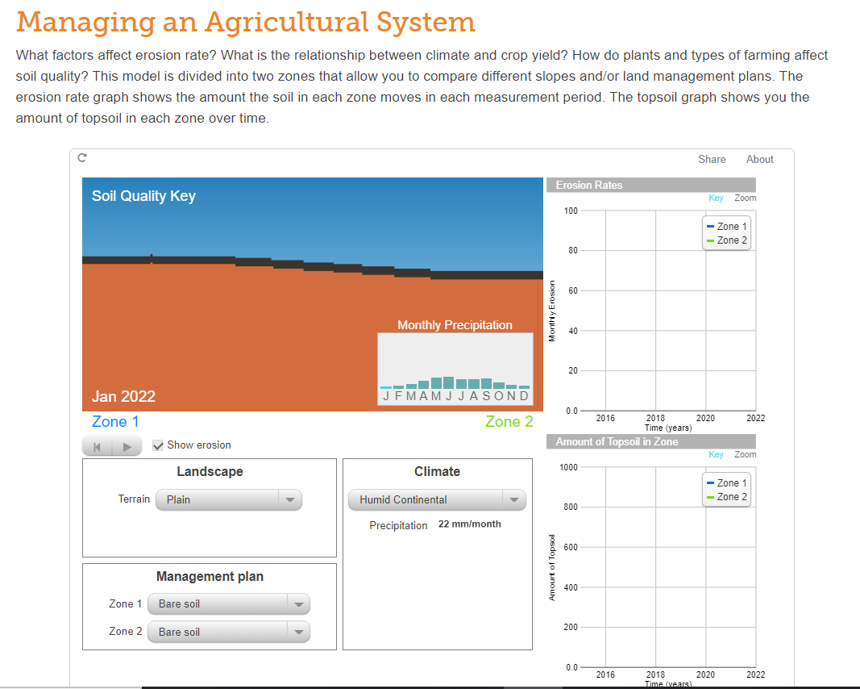
Elaborate
HAS: Can we feed the growing population?
Notes:
Can we feed the growing population? Screen shot of the modeling tool. If time, open the link, and demonstrate how it is used.
https://learn.concord.org/has-land

Slide 35
Phenomenon: Soil & our Climate System - Evaluate

Slide 36
Evaluate
What does this mean for me?
Task:
Consider the agricultural origin of the foods in three meals - breakfast, lunch, dinner
Use the content of this lesson to identify the following:
How will our changing climate affect the growth of the crops in my food?
How can agricultural practices be modified to be ensure crop productivity and more sequestered carbon into the future?
What can consumers to do to contribute positively to the climate change - food system issues?

Slide 37
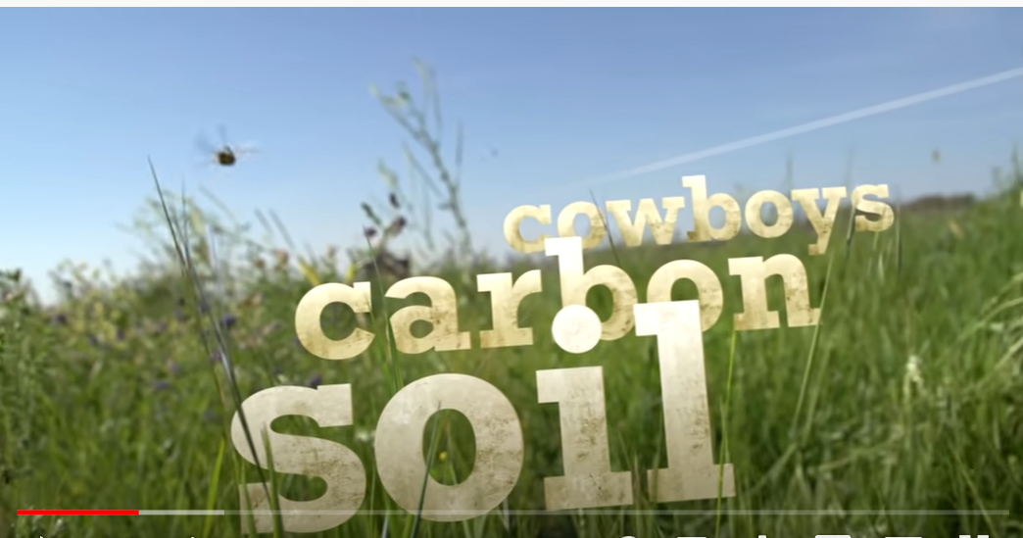
Evaluate
Solutions at work! - Introducing the Soil Carbon Cowboys
Notes:
This video demonstrates how regenerative agriculture methods works to replenish soils.
https://www.youtube.com/watch?v=MDoUDLbg8tg

Slide 38
NGSS Performance Expectations
MS-LS2-3 Ecosystems: Interactions, Energy, and Dynamics
Develop a model to describe the cycling of matter and flow of energy among living and nonliving parts of an ecosystem.
MS-LS2-5 Ecosystems: Interactions, Energy, and Dynamics
Evaluate competing design solutions for maintaining biodiversity and ecosystem services.
HS-ESS2-2 Earth's Systems
Analyze geoscience data to make the claim that one change to Earth's surface can create feedbacks that cause changes to other Earth systems.
HS-ESS2-6 Earth's Systems
Develop a quantitative model to describe the cycling of carbon among the hydrosphere, atmosphere, geosphere, and biosphere.
HS-ESS2-7 Earth's Systems
Construct an argument based on evidence about the simultaneous coevolution of Earth’s systems and life on Earth.
HS-ESS3-1 Earth and Human Activity
Construct an explanation based on evidence for how the availability of natural resources, occurrence of natural hazards, and changes in climate have influenced human activity.
Notes:
Next Generation Science Standards (NGSS) connected to this 5-E lesson.

Slide 39
Resources
Know Soil Know Life, Chapter 8
Soils and Society
Know Soil Know Life, Educators Guide, Online:
https://serc.carleton.edu/kskl_educator/soil_society/index.html

Slide 40
Soil and Climate
Questions?
Comments?
Thank you!

