Slide 1
Soil Basics/Physical Properties
Maninder K. Walia, University of Nevada, Reno

Slide 2
Soil Sampling
Protocols and Techniques
Soil Probe
Clean Ziploc bag
Depth
Number of Samples
Notes:
Will collect some soil sample using the materials provided and use in the soil class today.

Slide 3
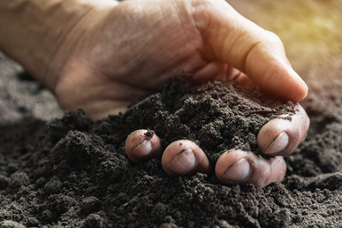
Definition of SOILS
The unconsolidated mineral or organic material on the immediate surface of the earth that serves as a natural medium for the growth of land plants.
Notes:
This is the text book definition. Soil, as formally defined in the Soil Science Society of America Glossary of Soil Science Terms, is: Basically, it says that soils are dynamic and reflect the conditions that they formed under. Because they do reflect the environment in which they formed we can use their morphology to understand more about the environment.

Slide 4
What is SOIL made of?
A soil is composed of
Mineral,
Air,
Water
And organic matter (living or dead material)
It forms at the surface of land – it is the “skin of the earth.”
Notes:
Mineral (inorganic): Particles of sand, silt, and clay. Derived from rock. (typically 45 to 49 percent)
Organic Matter: Decayed and decaying plants and animals. (typically 1 to 5 percent)
Water and Air typically comprise 50 percent of the soil in dynamically varying percentages.

Slide 5
SOIL is a complex three-phase system
Comprises of:
Solids (soil mineral particles and organic matter),
Liquids (the soil solution: water, dissolved nutrients, chemicals, and gases), and
Gases (e.g., N₂, O₂, CO₂)
Notes:
Soil is a three-phase system; solid, liquid and gas. The proportion of each phase may vary, but ideally, it consists of 50% solid, 25% liquid, and 25% gas.
The solid phase of a soil system can be comprised of soil particles that are either mineral (i.e., rocks, stones, cobbles, gravel, sand, silt, clay) or organic (i.e., soil organic matter) in nature.
Liquid consists of soil solution as water, nutrients, and chemicals.
Gas as gases.

Slide 6
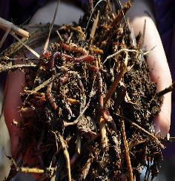
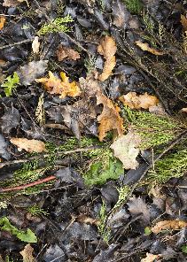
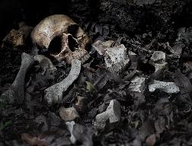
Solid Material
Minerals – inorganic material
Organic Matter
Living material
Bacteria, actinomycete, fungi, etc
Worms
Larger critters
Dead material
Leaf litter
Dead roots
Decomposing critters
Notes:
Solid material as organic matter as living and dead material. And inorganic materials in the soil, ultimately derived from rocks

Slide 7
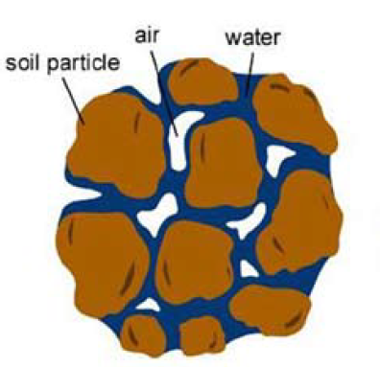
Pore Space
Image Credit: extension.unr.edu/publication.aspx?PubID=3418
Notes:
The pore space in soil represents that part of the soil volume which has been occupied by air or water. It’s a gap between solid particles which contains water and air. The pore space of soil contains the liquid and gas phases of soil, The pore space of soil may contain the habitat of plants (rhizosphere) and microorganisms.

Slide 8
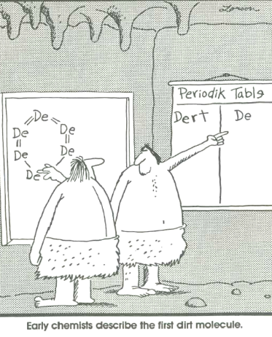
Does Soil = Dirt?
Notes:
Soil is not a dirt. Dirt is a four-letter word we will not use in this module. Soil is so much more than just dirt.

Slide 9
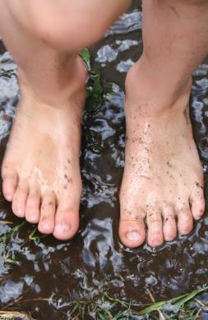
NO!
Dirt is the stuff under your fingernails or what gets on your clothes.
Notes:
Dirt is what you sweep up off your floor, its unwanted and unnecessary. It may be soil out of place like weed is a plant out of place.
It is “dead.” Lost the characteristics that give it the ability to support life- DEAD
Soil, on the other hand is essential for life.

Slide 10
Soil ≠ Dirt
Notes:
Soil ≠ Dirt

Slide 11
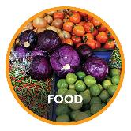
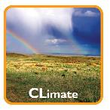
Why is SOIL Important?
Media for the growth of all kinds of plants.
Modify the atmosphere by emitting and absorbing gases
Habitat for animals
Media for the construction
Act as a living filter to clean water
Capture carbon
Notes:
Soil is a medium for plant growth that supplies water and important nutrients to plants, holding roots firmly.
Modifies the atmosphere by emitting and absorbing gases (carbon dioxide, methane, water vapor, and the like) and dust.
Provide habitat for animals that live in the soil
Media for the construction of foundations, roadbeds, dams, and buildings
Act as a living filter to clean water before it moves into an aquifer
Also, helps to capture Carbon from the atmosphere (sequestration)

Slide 12
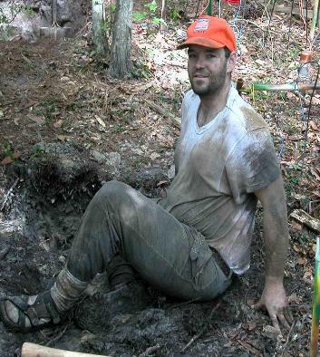
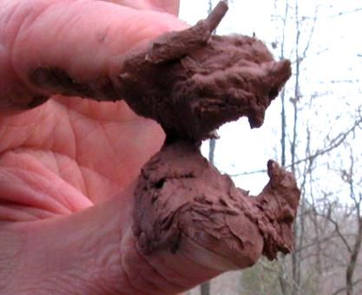
Soil makes great mud pies
…and is just plain fun!

Slide 13
Soil Formation Factors or CLORPT!
Climate
Organisms
Relief
Parent Material
Time
Notes:
There are many different soils in the world (over 10,000!). All are different because of where and how they formed. Soils differ from one part of the world to another, even from one part of a backyard to another. They differ because of where and how they formed. Five major factors interact to create different types of soils: Together these factors are called “ClORPT” – pronounced CLORPT!
The soil forms through the interaction of these factors. No one factor is more important to the formation of a soil but some factors may plan a larger role in the formation of a particular soil.
What are the factors of soil formation? To help you think of them, think of things that influence you or have made you the way you are: i.e. parents = parent material; where you live = climate and relief, vegetation; how old you are = time; influence of others (teachers etc.) = organisms

Slide 14
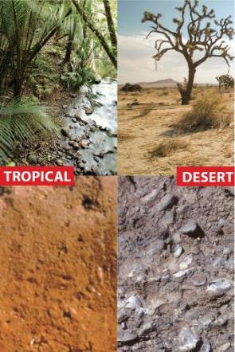
Climate
Major Climatic Forces
Temperature
Precipitation
Climatic conditions directly influence the weathering of materials in the soil.
Image Credit: SOIL! Get the Inside Scoop, D. Lindbo and others, ©2008 Soil Science Societies of America
Notes:
Climate can have profound effects on regional differences between soils. However, on a given 1 acre site, climatic conditions will generally be the same across it.
Temperature and moisture influence the speed of chemical reactions, which in turn help control how fast rocks weather and dead organisms decompose. Soils develop faster in warm, moist climates and slowest in cold or arid ones
Examples of Temperature/Precipitation relationships: Hot-Dry (desert), Cold-Dry (Antarctica), Hot-Wet (tropics), Cold-Wet (northern Canada) Desert
Weathering is the breakdown or disintegration of rock, minerals, and organic materials at or near the Earth’s surface. Two types of weathering processes – mechanical (physical) or chemical. Mechanical weathering is the physical breaking of rocks into smaller pieces. Chemical weathering is the process in which materials decompose due to chemical reactions such as dissolution, hydrations, and oxidation-reduction reactions.

Slide 15
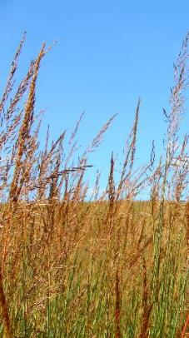
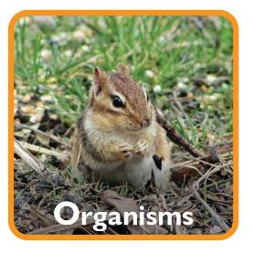
Organisms
Plants
Animals
Micro- and Meso-organisms
Bacteria
Fungi
Worms, Insects
Notes:
—Plants root, animals burrow, and microrganimsms– these and other organisms speed up the breakdown of large soil particles into smaller ones.
Microorganisms, plants, and animals help to form soil by adding organic matter, aiding in decomposition, and mixing/aerating (bioturbation).
Plant roots spread breaking up rocks and soils.
Animals and insects are mostly involved in mixing the soil, permitting more air and water to enter. They also enrich the soil by breaking down organic matter into available nutrients. Of course, they also decompose (like organisms).
Meso organisms are the mid-sized organisms that range from about 2 mm down to 0.2 mm (~0.01) in diameter. These include mites, springtails, and smaller worms. Some of these organisms are visible to the naked eye, but many are difficult to see without some magnification. Finally, the microorganisms are the small ones, less than 0.2 mm in diameter. In general, these can only be seen using microscopes, though large masses of fungal filaments can sometimes be seen.

Slide 16
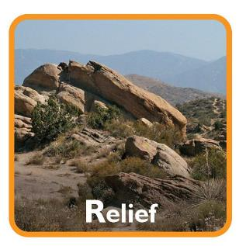
Relief (Landscape)
Also known as topography
Shape – hills/mountains vs flat/low-lying areas
Slope – steepness
Elevation – height above sea level
Aspect – direction a slope faces
Notes:
Relief can greatly influence soil development. The primary reason should be due to drainage and water movement. Soil developed on different parts of the landscape reflect the effects of drainage. Soils on steeper slopes tend to be drier than in flatter areas because of increased runoff.
The shape of the land and the direction it faces make a difference in how much sunlight the soils gets and how much water it keeps.
Deeper soils form at the bottom of a hill because gravity and water move soil particles down the slope
Slope– erosion, stability – steeper slopes have greater particle movement downhill because of gravity and water movement.
Elevation – The higher you are, the cooler it gets. Elevation can affect climate experienced, such as desert floor but the snow-capped summit

Slide 17
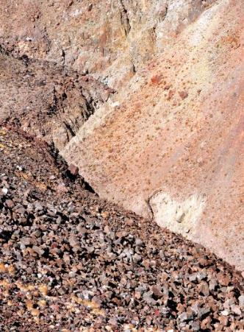
Parent Material
Every soil “inherits” traits from the parent material from which it formed.
Image Credit: SOIL! Get the Inside Scoop, D. Lindbo and others, ©2008 Soil Science Societies of America
Notes:
Like we inherited some traits from our parents, —Every soil “inherits” traits from the parent material from which it formed. For example, soils that form from limestone are rich in calcium and soils that form from materials at the bottom of lakes are high in clay.

Slide 18
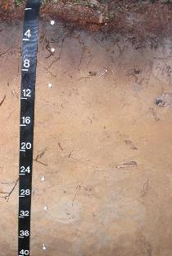
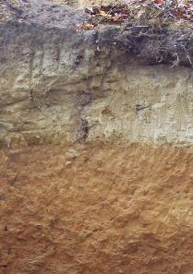
Time
Older soils differ from younger soils.
As soil ages, it starts to look different from its parent material.
YOUNG
few horizons
OLDER
more horizons
Image Credit: D. Lindbo and Wale Adewunmi, Know Soil Know Life contributors
Notes:
Time is the length of time that a surface has been exposed to weathering and biotic forces.
All of these factors work together over time. Older soils differ from younger soils because they have had longer to develop. As soil ages, it starts to look different from its parent material. That is because soil is dynamic. Its components—minerals, water, air, organic matter, and organisms—constantly change.
Time should be considered not only for how old soil is but also in terms of long it will take for certain soil properties to develop or redevelop after soil is disturbed.
Answer: hundreds to thousands of years – depending on all of the CLORPT factors!

Slide 19
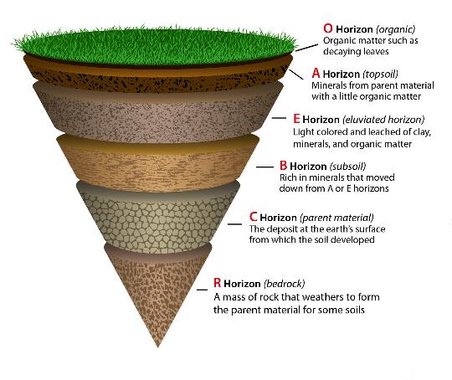
Soil Profile
Image Credit: : SOIL! Get the Inside Scoop, D. Lindbo and others, ©2008 Soil Science Societies of America
Notes:
There are different types of soil, each with its own set of characteristics. Dig down deep into any soil, and you’ll see that it is made of layers, or horizons (O, A, E, B, C, R). All soils have layers called horizons. These horizons may look different and they tell the story of how soil is formed over time. Put the horizons together, and they form a soil profile. Like a biography, each profile tells a story about the life of a soil. Most soils have three major horizons (A, B, C) and some have an organic horizon (O).
O – (humus or organic) Mostly organic matter such as decomposing leaves. The O horizon is thin in some soils, thick in others, and not present at all in others.
A - (topsoil) Mostly minerals from parent material with organic matter incorporated. A good material for plants and other organisms to live.
E – (eluviated) Leached of clay, minerals, and organic matter, leaving a concentration of sand and silt particles of quartz or other resistant materials – missing in some soils but often found in older soils and forest soils.
B – (subsoil) Rich in minerals that leached (moved down) from the A or E horizons and accumulated here.
C – (parent material) The deposit at Earth’s surface from which the soil developed.
R – (bedrock) A mass of rock such as granite, basalt, quartzite, limestone or sandstone that forms the parent material for some soils.

Slide 20
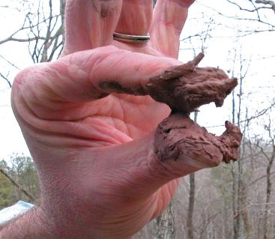
Physical Properties
Soil Color
Soil Texture
Reflects how soil mineral and organic particles combine to form the soil matrix and pore spaces
Determines
Water-holding capacity
Permeability
Soil Science Society of America www.soils.org | www.soils4teachers.org
Image Credit: D. Lindbo and Wale Adewunmi, Know Soil Know Life contributors
Notes:
There are many soil properties that help us describe and manage soils. Soil physics is the study of heat, water, and gas flow into, through, and out of the soil. Some of the important physical properties are described below.
Soil color is influenced primarily by soil mineralogy – telling us what is in a specific soil.
Soil texture is the proportion of sand, silt and clay particles.
Permeability is the soils ability to allow water to pass through it.

Slide 21
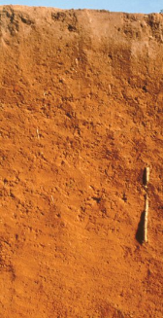
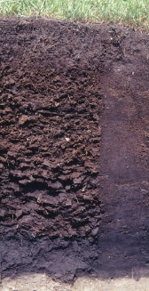
Soil Color
Oxisols
Histosols
Notes:
Soil color is influenced primarily by soil mineralogy – telling us what is in a specific soil. Soils high in iron are deep orange-brown to yellowish-brown. Soils high in organic matter are dark brown to black. Soil color can also tell us how a soil “behaves” – soils that drain well are brightly colored and soils that are wet and soggy will have mottled patterns of grays.
Oxisols (from French oxide, "oxide") are very highly weathered soils that are found primarily in the tropical and subtropical regions of the world. These soils contain few weatherable minerals and are often rich in Fe and Al oxide minerals.
Histosols are soils that are composed mainly of organic materials. They contain at least 20-30% organic matter by weight. Histosols typically form in settings where poor drainage inhibits the decomposition of plant and animal remains, allowing these organic materials to accumulate over time. Histosols are often referred to as peats and mucks.

Slide 22
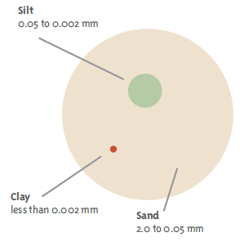
Soil Texture
Every soil can be separated into 3 physical sizes based on the diameter of particles.
Sand particles are the largest
Clay particles are the smallest.
Most soils are a combination of the three.
Sand + Silt + Clay = Soil Texture
Image Credit: SOIL! Get the Inside Scoop, D. Lindbo and others, ©2008 Soil Science Society of America
Notes:
Sand, silt, and clay are the inorganic, mineral components of soil. Every soil can be separated into 3 physical sizes based on the diameter of the particles.
The relative percentages of sand, silt, and clay are what give soil its texture

Slide 23
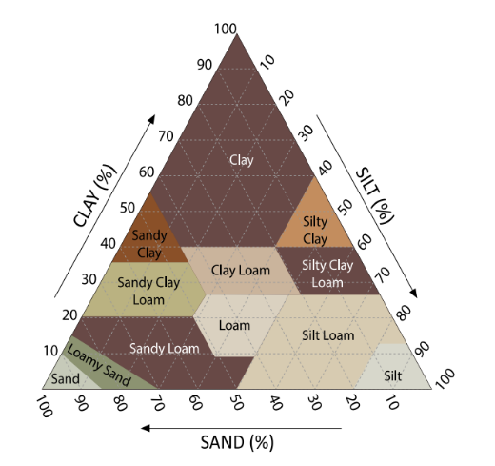
Soil Texture Triangle
12 soil textural classes
Soil Science Society of America www.soils.org | www.soils4teachers.org
Image Credit: SOIL! Get the Inside Scoop, D. Lindbo and others, ©2008 Soil Science Society of America
Notes:
There are 12 soil textural classes represented on the soil texture triangle on the right. Each texture corresponds to specific percentages of sand, silt, or clay. Knowing the texture helps us manage the soil

Slide 24
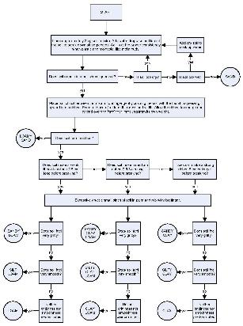
Soil Texture by Feel Method
Developed by Natural Resources Conservation Service (NRCS) for estimating soil texture in the field
Materials needed:
Soil sample
Water
Flow chart
Notes:
Determine the soil texture using Feel method developed by NRCS. Follow the steps using flow chart (clicking link) to determine soil texture in the classroom. Use the collected soil sample for this texture determination.

Slide 25
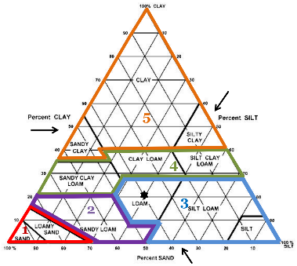
Soil Texture Activity
* CAUTION: Add water by drops & do not make too wet.
Moisten a soil sample to about the consistency of play-do.
Try to form the sample into a ball in the palm of your hand. If the sample will not stay together to form into a ball, the sample is in GROUP 1.
Toss or bounce the ball in your palm, if the ball falls apart the soil is in GROUP 2.
If it stays together place it between both palms and rub them together vigorously. If the ball comes apart the soil is in GROUP 3.
If it stays together, place it between your thumb and index finger. Apply pressure and rub the sample smoothing it out on your thumb. If the sample is ruffled or broken the soil is in GROUP 4.
If soil is slick and shiny, with a soap appearance and feel soil is in GROUP 5.
Notes:
Follow the steps to determine soil texture in the classroom.

Slide 26
If the soil feels floury and smooth it is probably a silt loam or silt.
If the sample feels gritty (sand) it will usually be on the left side of group,
If it falls into group 3 and feels gritty it is probably a loam;
Notes:
This slide also shows soil triangle.

Slide 27
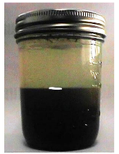
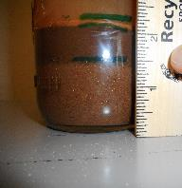
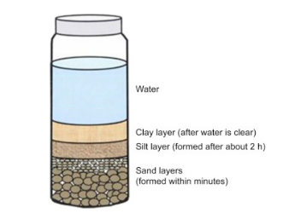
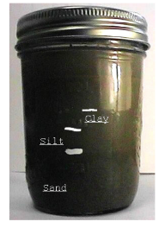
Soil Texture by Jar Method
Image Credit: sciencedirect.com; NMSU and hgic.clemson.edu
Notes:
There is another method to determine soil texture, named as jar method and the activity is in their workbooks.

Slide 28
Soil Texture by Jar Method- Calculations
Calculate the percentage of each soil texture using the formulas below:
Height of sand layer ________inches
Height of silt layer ________inches
Height of clay layer ________inches
TOTAL HEIGHT OF LAYERS ________inches
% Sand = (Sand depth/Total depth) x 100
% Silt = (Silt depth/Total depth) x 100
% Clay = (Clay depth/Total depth) x 100
0.2 inches
0.7 inches
1.4 inches
Image Credit: sciencedirect.com; NMSU and hgic.clemson.edu
Notes:
Here is an example, using the heights of different soil layers to calculate the percentage of each particle and determine the soil texture.
For example: %Sand= (1.4/2.3) x 100=60.9%
%Silt= (0.7/2.3)x 100= 30.4%
%Clay= (0.2/2.3)x100= 8.7%
Total=100%, class= sandy loam

Slide 29
Soil Basics Resources
Know Soil Know Life, Chapter 1:
Know Soil, Know Life
Know Soil Know Life Educators Guide, Online:
https://serc.carleton.edu/kskl_educator/soil_life/index.html
Know Soil Know Life, Chapter 2
Physical Properties of Soil and Soil Formation
Know Soil Know Life Educators Guide, Online:
https://serc.carleton.edu/kskl_educator/soil_formation/index.html

