Slide 1
How Do Soils Form?
CLORPT for short
Notes:
Be able to describe the factors of formation.
CLimate – temperature, rainfall etc.
Organisms – plants (grassland, conifers, deciduous), animals (burrowing), insects (ants, termites), microorganisms (desert crusts, decomposers)
Relief – topography, position on the landscape relates to drainage and water movement
Parent Material – geologic material soil developed from
Time – how long the soil has been developing or weathering
Give an example of each factor of formation.
CLimate – desert vs arctic – temperature – slow decomposition in colder areas
Desert vs forest – rainfall – more rain (water) more organic mater more vegetation
Organism – pine trees have needles that are acidic. As water mores through these and into the soil organic acids are released and the soil is leached more as compared to soil under deciduous trees
Relief – soils in the upper slope areas tend to be better drained (drier) than those at the base of the slope or in low lying areas – swampy areas
Parent Material – soils formed on limestone are less acidic than those formed on granite
Time – more horizons will develop over time

Slide 2
CLORPT
for
short
Soils differ from one part of the world to another, even from one part of a backyard to another. They differ because of where and how they formed. And over time, five major factors control how a soil forms. These factors are climate, organisms, relief (landscape), parent material, and time. That is CLORPT for short!
Notes:
What are the factors of formation. To help you think of them think of things that influence you or have made you the way you are: i.e. regionally where you live (i.e. south west, northeast, southeast, mid west etc.) = climate; what you eat = organisms; where on the landscape you live = relief; parents = parent material; how old you are = time;

Slide 3
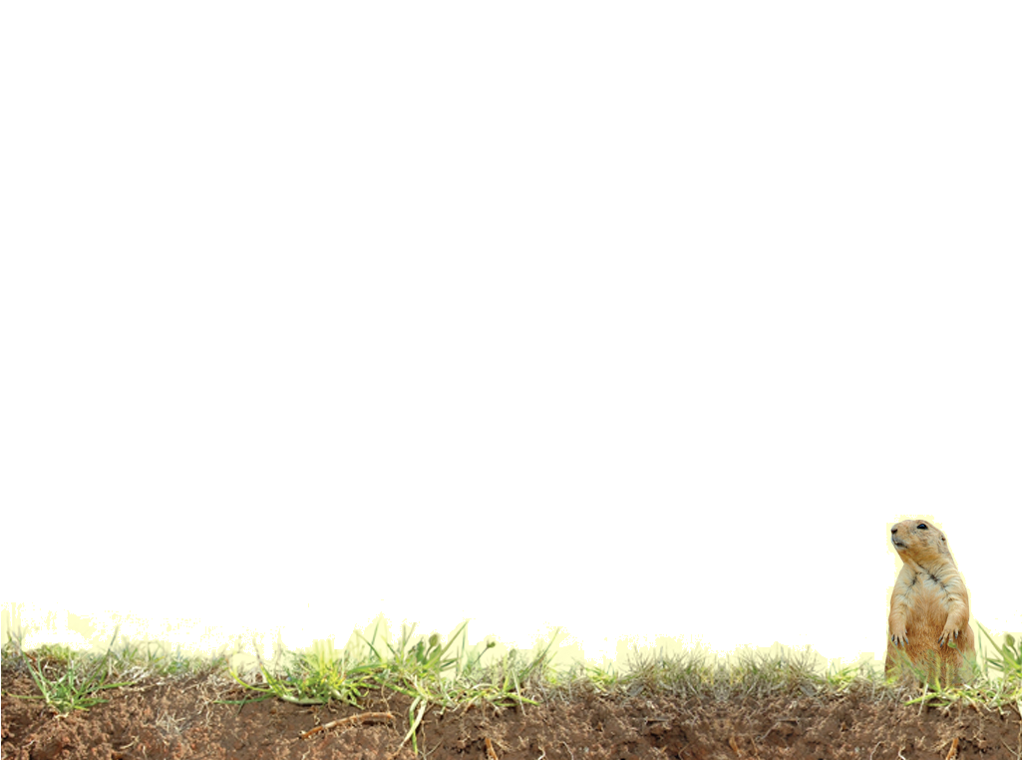
Factors of formation
Climate
Organisms (Vegetation/Biology)
Relief (Topography)
Parent Material
Time
Notes:
Hans Jenny - http://en.wikipedia.org/wiki/Hans_Jenny_(cymatics)
originally came up with the 5 factors in 1942. Some add anthropogenic (man) as a 6th factor due to the extreme and widespread influence man can have, others consider man as part of the Biology factor.
The soil forms through the interaction of these factors. No one factor is more important to the formation of a soil in the grand scheme.

Slide 4
Climate
Notes:
Climate is the CL in CLORPT. It includes all aspects of climate from temperature to rainfall (snowfall) to wind and amount of sunlight.

Slide 5
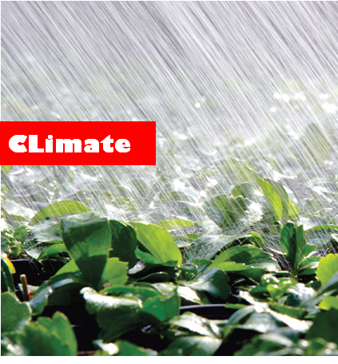
Temperature and Moisture influence the speed of chemical reactions, which in turn, control how fast rocks weather and dead organisms decompose.
Notes:
Climate. As temperature increases weathering increases. Rain or water added also increase weathering.

Slide 6
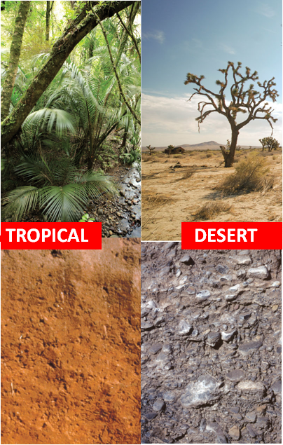
Soils develop fastest in warm, moist climates, and slowest in cold and arid ones.
Notes:
Warm and wet – tropics – weather faster than cold and dry (Antarctica) or even hot and dry

Slide 7
Organisms
aka biology or vegetation
Notes:
Life in the soil or Organisms is the O in CLORPT

Slide 8
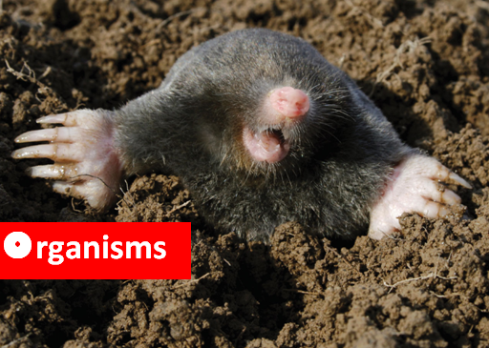
Plant roots spread out, animals burrow, and bacteria eat. These and other soil organisms speed up the breakdown of large soil particles into smaller ones.
Notes:
Organisms – roots give off CO2 and organic acids that break down minerals and other organic materials. Bacteria, fungi, and worms (decomposers) help to break down organic matter as well. Roots can physically break rocks to allow for water to enter and further weather the soil.

Slide 9
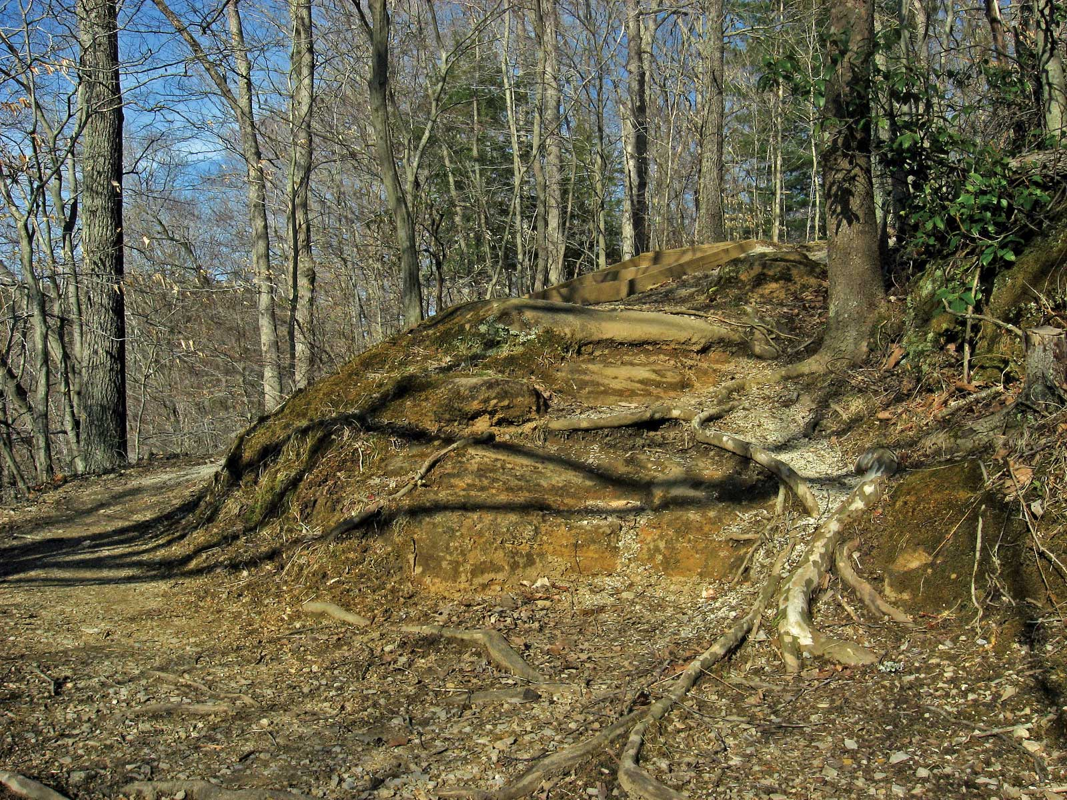
Organisms
Roots are a powerful soil-forming force, cracking rocks as they grow. And roots produce carbon dioxide that mixes with water and forms an acid that wears away rock.
Notes:
Root, lichens and other biologic factors all combine to form soil. The CO2 combines with water to make a weak acid the weathers particles. Water leaching through decomposing leaf litter – particularly coniferous litter – create organic acids that further leach and weather the soil (see forest soil section for example).

Slide 10
Relief
Topography
Notes:
Relief is the R in CLORPT. It is also known as topography.
Topography or slope position can greatly influence soil development. Think to your if you would rather build a dream house on the top of a hill or the bottom. Why? The primary reason has to due with drainage and water movement. Soil developed on different parts of the landscape reflect the effects of drainage.

Slide 11
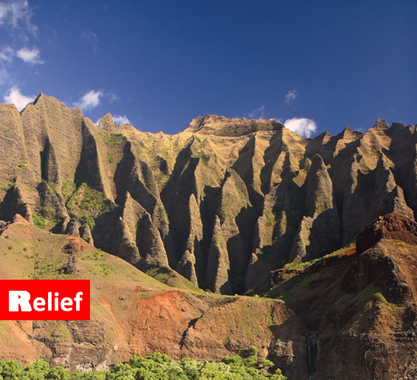
The shape of the land and the direction in faces makes a difference in how much sunlight the soil gets, and how much water it keeps.
Notes:
Relief – Shape and aspect (where the surface faces) affect the soil development. Steep slopes show less development as they are likely to erode and are unstable. South facing slopes in the northern hemisphere will show more development as they are warmer.

Slide 12
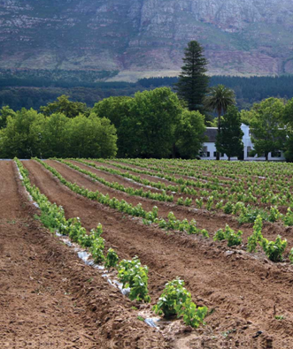
Deeper soils form at the bottom of a hill than at the top because gravity and water move soil particles down the slope.
Notes:
Stable and or flat landscapes show more development – deeper and more horizons. Also these areas may be an area where particles (sediment)from up slope accumulate.

Slide 13
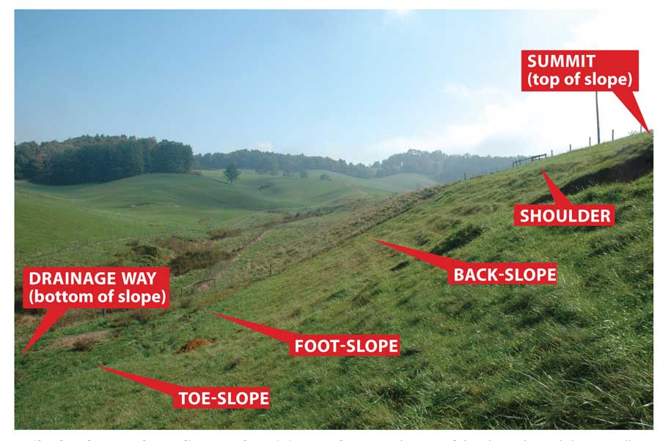
Names of Slope Locations
SUMMIT
(top of slope)
SHOULDER
DRAINAGE WAY
(Bottom of Slope)
BACK-SLOPE
FOOT SLOPE
TOE SLOPE
Notes:
Soils change on a landscape depending on where it is on the slope. This shows the names of the parts of the landscape. The next slide shows what the soil look like at each position

Slide 14
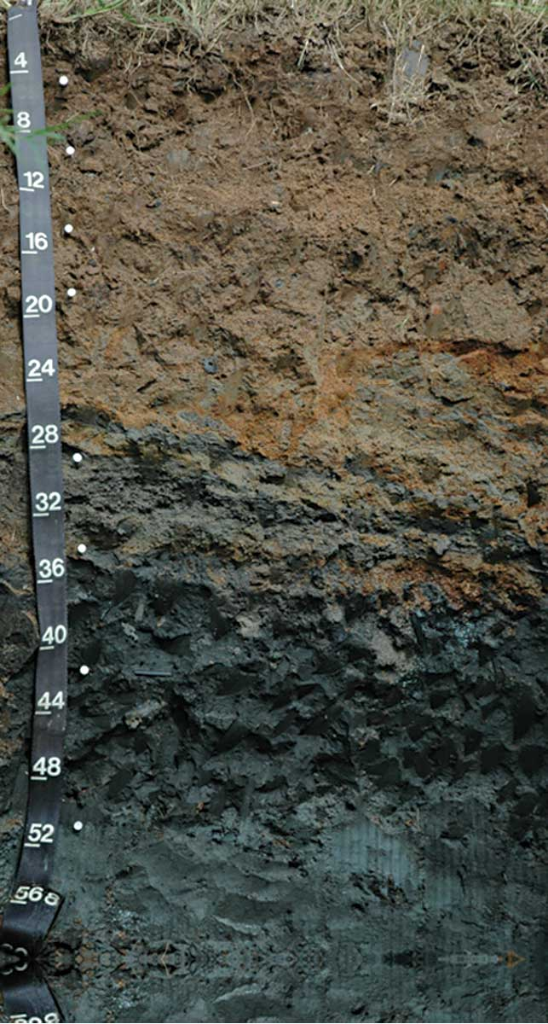
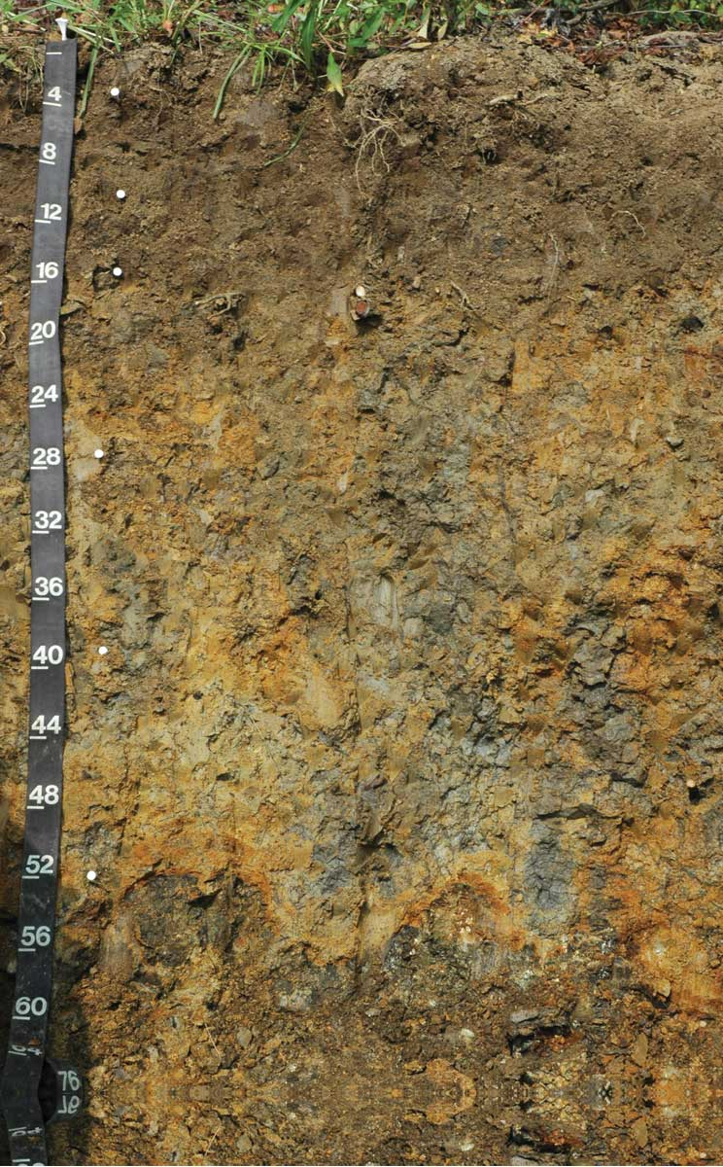
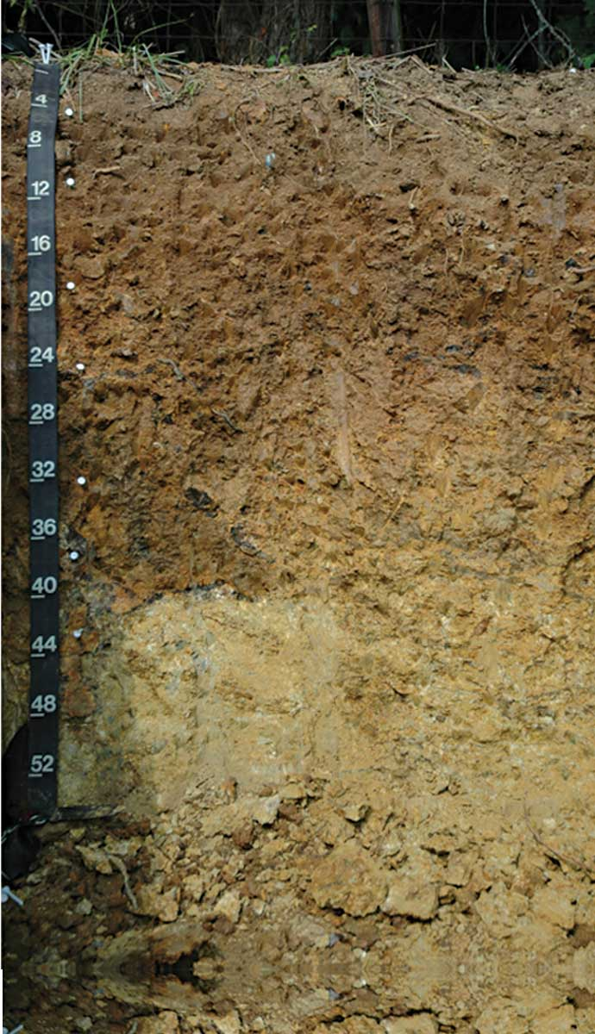
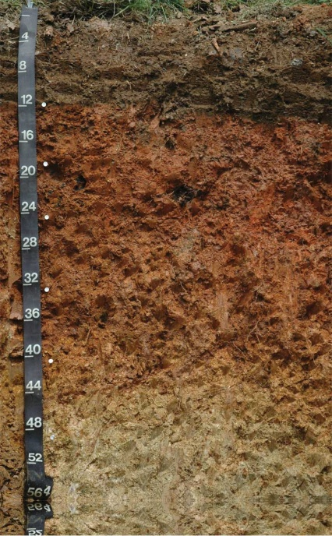
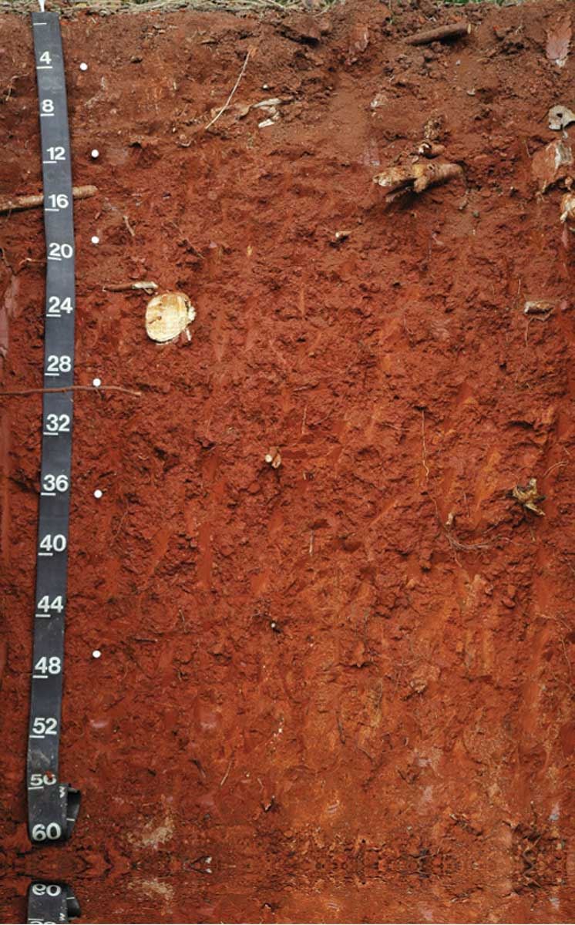
Soil Color Change in Different Slope Locations
DRAINGE WAY
TOE-SLOPE
FOOT-SLOPE
SHOULDER
SUMMIT
Color can tell us about how a soil “behaves”. A soil that drains well is brightly colored. One that is wet and soggy has an uneven (mottled) pattern of grays, reds, and yellows.
Notes:
Soil color changes based on landscape position (see soil properties section for an explanation of hw color is related to drainage or how wet the soil is).
Well drained soil at summit is red – well oxidized or “rusty”. Soil gets gray down slope as water remains in the profile longer. This first causes the soil to have a few gray splotches or mottles. When the soil is saturated for a long enough period it may have a dominantly gray color as seen in the drainage way profile. Soil color changes from bright red, to yellow, to gray the further down the soil profile that you get.

Slide 15
Parent Material
Notes:
Parent Material is the P in CLORPT. Just as you and I have parents so do soils. Many of the soil properties as ours are inherited from their parents.

Slide 16
Just like you inherited some characteristics from your parents, every soil inherits traits from the material from which it formed.
Notes:
Parent Material

Slide 17
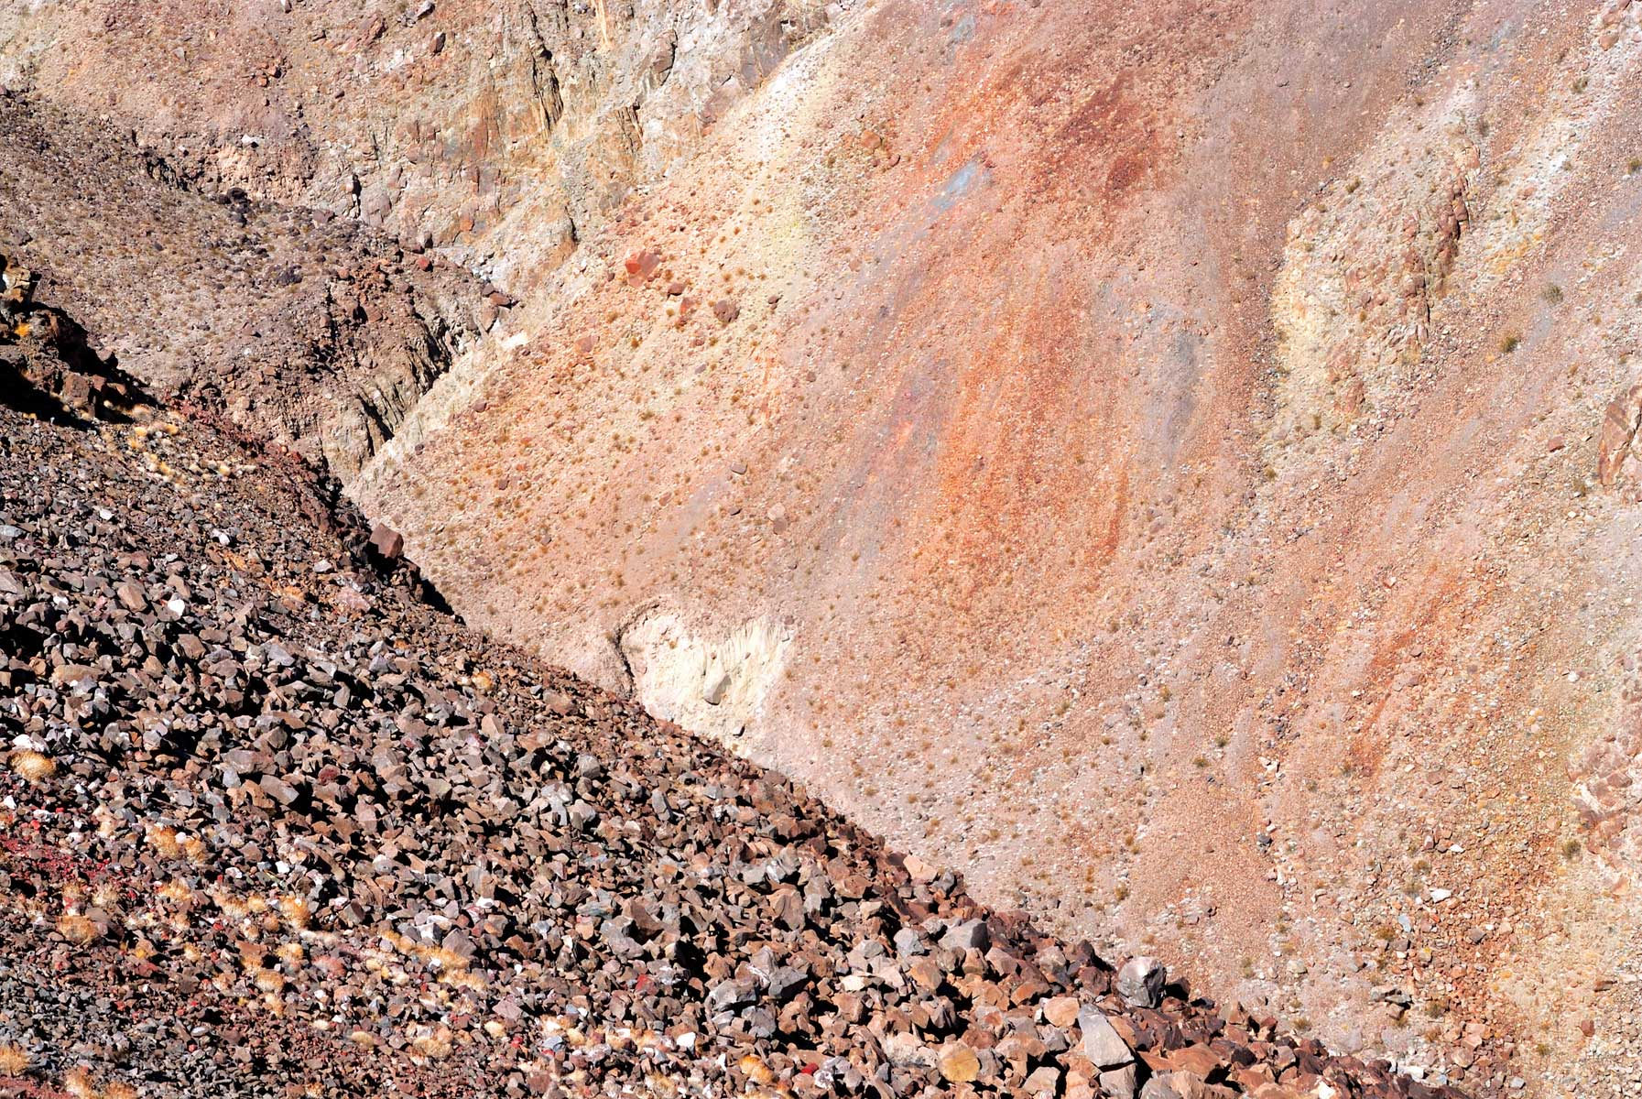
Soils that form in limestone bedrock are rich in calcium, Soils that formed from materials at the bottom of lakes are high in clay.
Notes:
Parent Material

Slide 18
Parent Material
Transported materials
Bedrock or residual material
Organic materials
Notes:
Parent materials can be broken into three basic groups.

Slide 19
Transported Sediments
Water transported or deposited
Marine
Fluvial
Lacustrine
Wind transported
Aeolian (loess)
Gravity transported
Colluvium
Ice transported
Glacial
Notes:
The group consisting of transported material is further subdivided based upon the media that transported the sediment.

Slide 20
Marine
Deposited in a marine environment
Variable texture dependent on energy of depositional environment
Low energy – fine textured
High energy – coarse textured
Notes:
The areas adjacent to the coast contain multiple environments for sediment deposition. Sediments deposited in this are are termed Marine sediments are are deposited in salt to brackish water.

Slide 21
Fluvial
Sediments deposited in rivers or floodplains
Texture coarsest near active channel
Notes:
Fluvial deposits are sediments deposited either in the active stream channel or on the flood plain associate with the channel. The sediments are coarser near the channel where the water is moving the fastest.

Slide 22
Bedrock or Residual Material
Properties related to mineral present in parent rock and weathering
Clay mineralogy
Inherent fertility
Particle size variable
Notes:
Soils can also be developed in place from the underlying bedrock. These are referred to a residual materials. The soil developed from these material inherit properties from the rock and the manner in which the rock weathers both physically and chemically.

Slide 23
Time
Notes:
Finally, Time is the T in CLORPT.

Slide 24
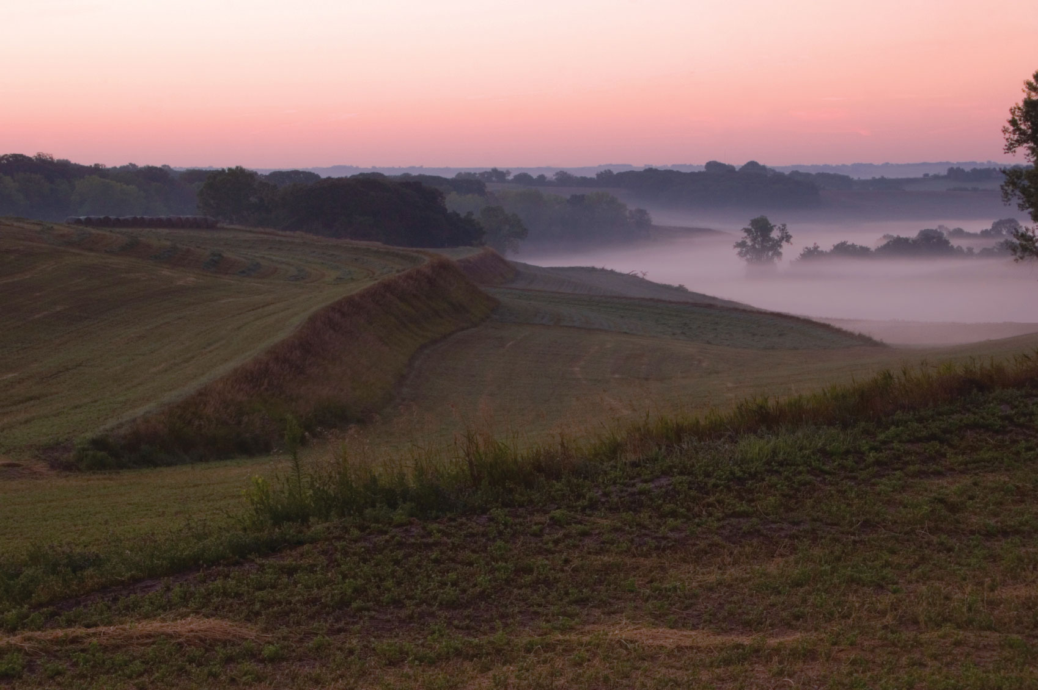
Time
Older soils differ from younger soils because they have had longer to develop
Notes:
More development means more horizons, redder color in the B, more clay in the B. However time does not always just mean true chronologic age to a soil scientist. For example a soil in Antarctica will show very little development and appear young since it is not highly weathered. On the other hand a tropical soil (warm and wet) will show more development as compared to the Antarctic soil even though it is chronologically or less age (younger)

Slide 25
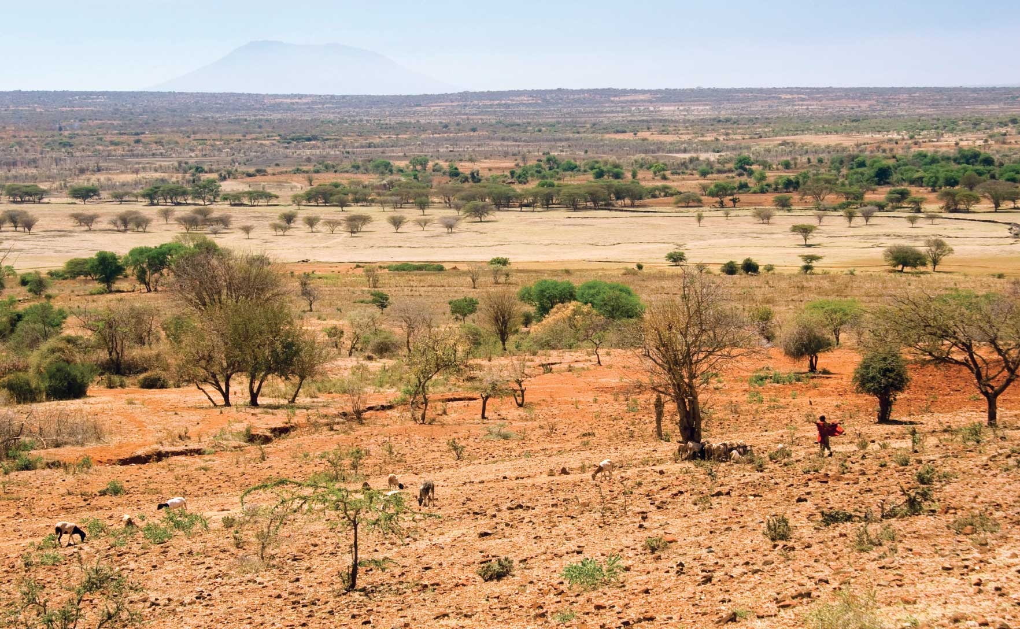
In the Northern U.S., soils tend to be younger, because glaciers covered the surface during the last ice age, which kept soils from forming. In the southern U.S., there were no glaciers. There, the soils have been exposed for a longer time, so they are more weathered.
Notes:
Soils in the northern US and Canada are younger as compared to those in the Southeast.

Slide 26
Each soil has its own history.
Charles Kellogg, Former Director, Soil Survey Division, USDA

Slide 27
Vocabulary
Bedrock
CLORPT
Developed soil
Organism
Organic Matter
Parent Material
Sediment
Slope
Relief
Weathering
Notes:
All these words are defined in Soil! Get the inside Scoop

Slide 28
Vocabulary
Time
Climate
Topography
Vegetation
Precipitation
Conifer
Deciduous
Aspect
Notes:
These are additional words with definitions below.
Time – one of the factors of soil formation – soils form over many years
Climate – one of the factors of formation usually considered to include temperature and precipitation. May also be influence by aspect which is the direction the land surface faces.
Topography - relief
Vegetation – plants growing in the soil
Precipitation – rainfall, snow fall etc.
Conifer – trees that have needles and generally stay green year found
Deciduous – trees that have leaves and lose them in the fall
Aspect – the direction the land surface faces

